Slide 1
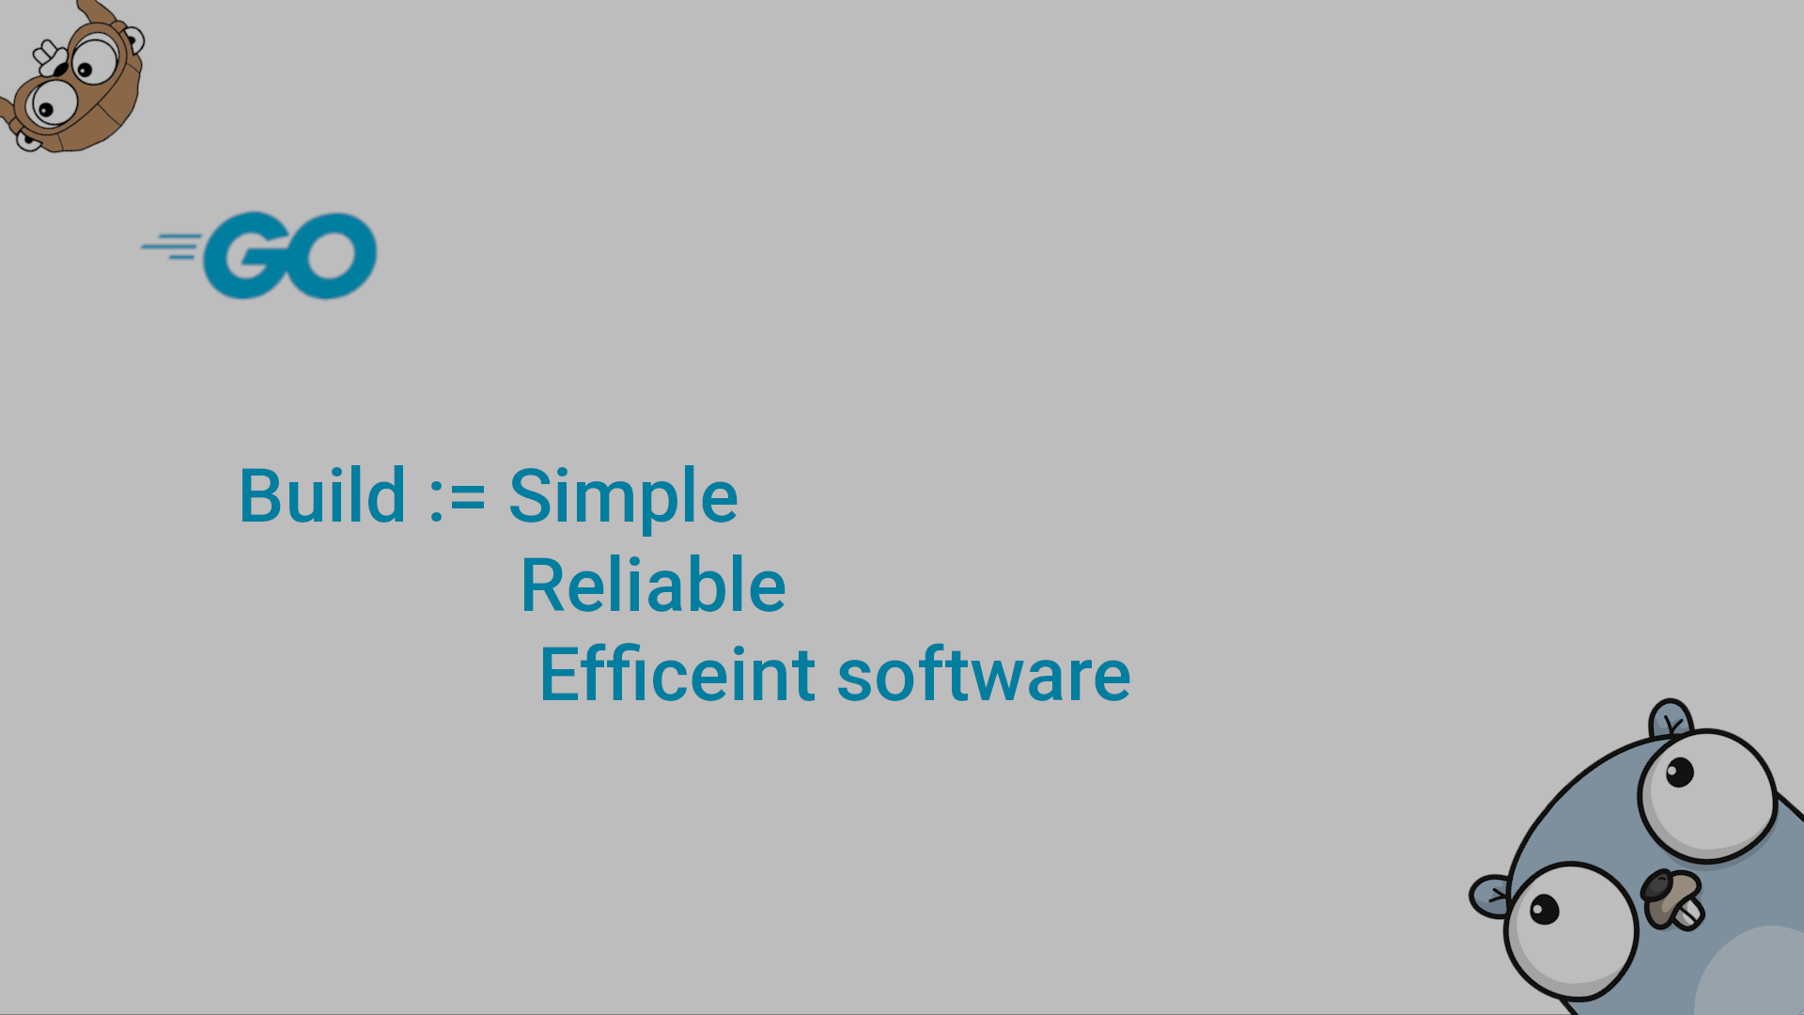
Goroutines and Channels

Slide 2
Intro:
Go comes with built-in support for communication between applications (networking, client-server, distributed computing) and support for concurrent applications.
These are programs that execute different pieces of code simultaneously, possibly on different processors or computers.
The basic building blocks Go proposes for structuring concurrent programs are goroutines and channels.
Do not communicate by sharing memory. Instead, share memory by communicating. Communication forces coordination.

Slide 3
Concurrency, parallelism and goroutines:
An application is a process running on a machine; a process is an independently executing entity that runs in its own address space in memory.
A process is composed of one or more operating system threads, which are simultaneously executing entities that share the same address space. Almost all real programs are multithreaded.
Such a concurrent application can execute on one processor or core using a number of threads, but it is only when the same application process executes at the same point in time on a number of cores or processors that it is truly called parallelized.
Parallelism is the ability to execute tasks efficiently by utilizing multiple processors. So concurrent programs may or may not be parallel.
Multithreaded applications are notoriously difficult to get right; the main problem is the shared data in memory, which the different threads can manipulate in a non-predictable manner
Do not use global variables or shared memory, they make your code unsafe for running concurrently.

Slide 4
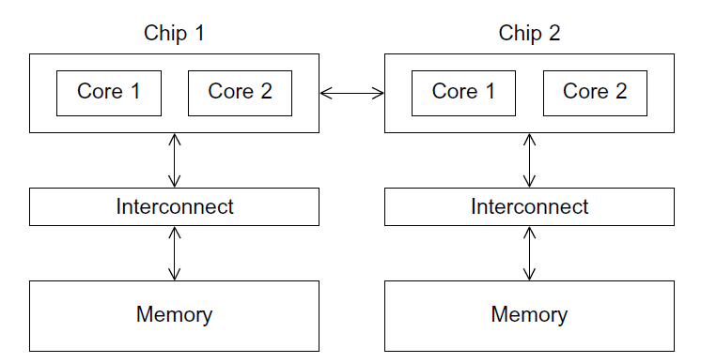
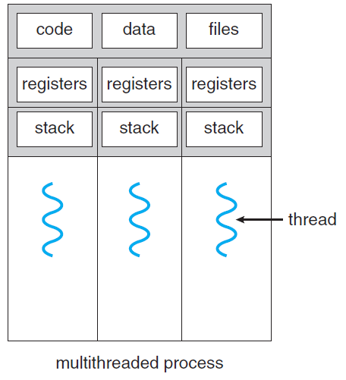
Concurrency, parallelism and goroutines:

Slide 5
Concurrency, parallelism and goroutines:
Active Threads
Their number is specified by the OS, and they give the program the parallelism property
core1
core2
core1
core2
core1
core2
Interconnect
Interconnect
Interconnect
Interconnect
Memory
Memory
Memory
Memory

Slide 6
Concurrency, parallelism and goroutines:
The parts of an application that run concurrently are called goroutines in Go; they are, in effect, concurrently executing computations. There is no one-to-one correspondence between a goroutine and an operating system thread
A goroutine is mapped onto (multiplexed, executed by) one or more threads, according to their availability; this is accomplished by the goroutine-scheduler in the Go runtime.
Goroutines run in the same address space, so access to shared memory must be synchronized; this could be done via the sync package, but this is highly discouraged: Go uses channels to synchronize goroutines
When a goroutine is blocked by a system call (e.g., waiting for I/O), other goroutines continue to run on other threads. The design of goroutines hides many of the complexities of thread creation and management
Goroutines are lightweight, much lighter than a thread. They have a very small footprint (use little memory and resources): they are created with a 4K memory stack-space on the heap. Because they are cheap to create, a great number of them can be started on the fly if necessary (in the order of 100 thousand in the same address space). Furthermore, they use a segmented stack for dynamically growing (or shrinking) their memory-usage; stack management is automatic. The stacks are not managed by the garbage collector; instead, they are freed directly when the goroutine exits.

Slide 7
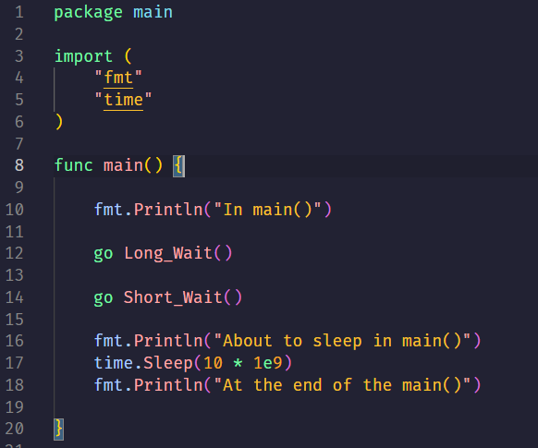
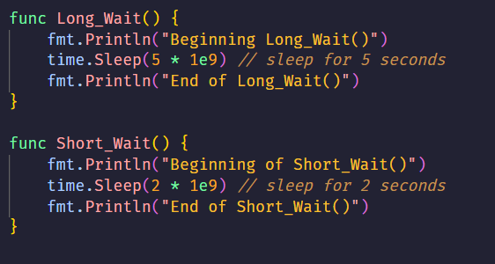
The Goroutines:
We let main() pause for 10s, so we are sure that it will terminate after the two goroutines
The most important question is what is the best way to synchronize the goroutines
When the function main() returns, the program exits: it does not wait for other (non-main) goroutines to complete.
The logic of your code must be independent of the order in which goroutines are invoked.

Slide 8
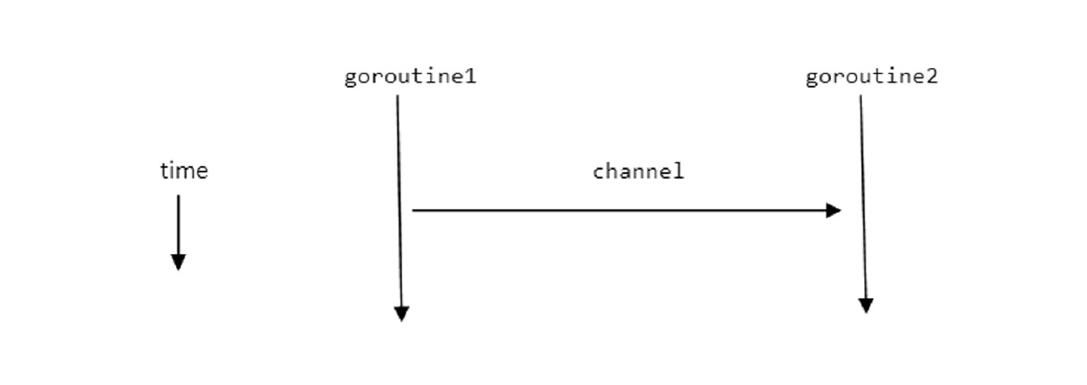
Channels:
In our example, the goroutines executed independently; they did not communicate. Of course, to be more useful, they have to communicate: sending and receiving information between them and coordinating/synchronizing their efforts
Goroutines could communicate by using shared variables, but this is highly discouraged because this way of working introduces all the difficulties with shared memory in multi-threading.
Instead, Go has a special type, the channel, which is like a conduit (pipe) through which you can send typed values, and which takes care of communication between goroutines, avoiding all the pitfalls of shared memory; the very act of communication through a channel guarantees synchronization
Data is passed around on channels: only one goroutine has access to a data item at any given time: so data races cannot occur, by design.

Slide 9
Channels:
var variable_name chan data-type [then allocate]; variable_name = make(chan data-type) instead, you can directly do: variable_name := make(chan data-type)
ch <- int1 [variable int1 is sent through the channel ch]
Int2 = <- ch [variable int2 receives data (gets a new value) from the channel ch]
<- ch [can on itself be used to take the (next) value from the channel, this value is effectively discarded]
The same operator <- is used for sending and receiving, but Go figures out, depending on the operands, what to do

Slide 10
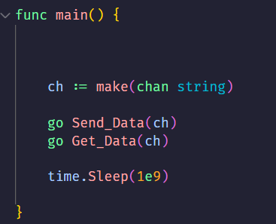
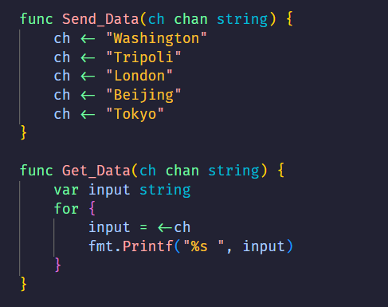
Channels:
Even if they run independently but function Get_Data will never go on until it receives messages from function Send_Data hence we control the order of processing
By default, communication is synchronous and unbuffered: sends do not complete until there is
a receiver to accept the value
But we still have the main function waiting
A send operation on a channel (and the goroutine or function that contains it) blocks until a receiver is available for the same channel and vice versa. A receive operation for a channel blocks until a sender is available for the same channel

Slide 11
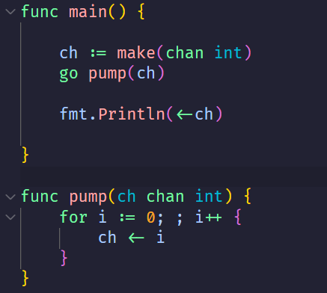
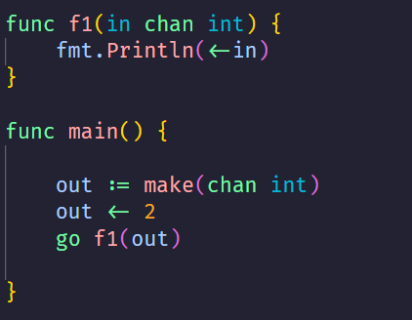
Channels (Bad Design):

Slide 12
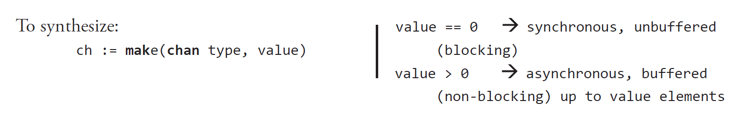
Asynchronous channels:
An unbuffered channel can only contain 1 item and is, for that reason, sometimes too restrictive. We can provide for a buffer in the channel, whose capacity gets set in an extended make command
Ch := make(chan string, 100); Sending to a buffered channel will not block unless the buffer is full (the capacity is completely used), and reading from a buffered channel will not block unless the buffer is empty
If you use buffers in the channels, your program will react better to sudden increases in the number of ‘requests’: it will react more elastically, or with the official term, it will be more scalable.

Slide 13
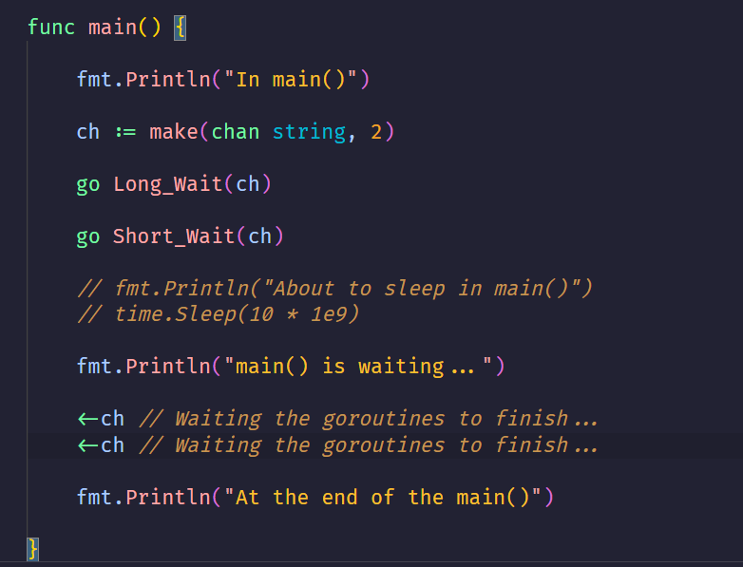
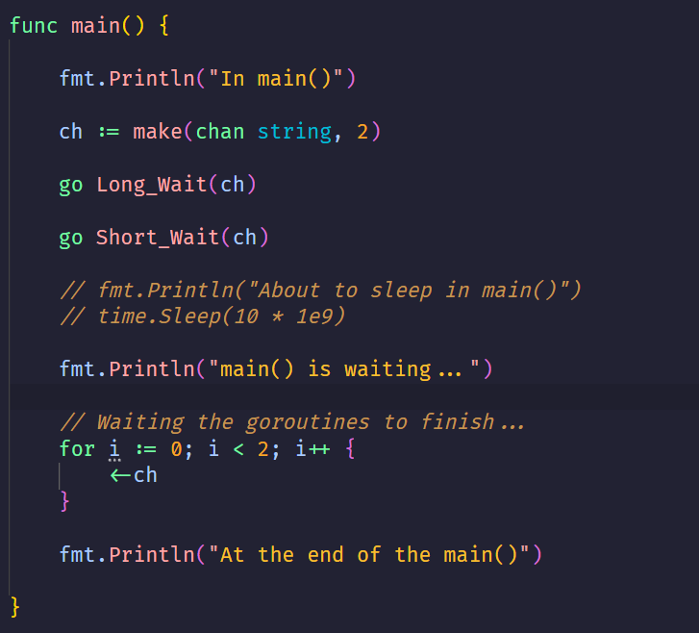
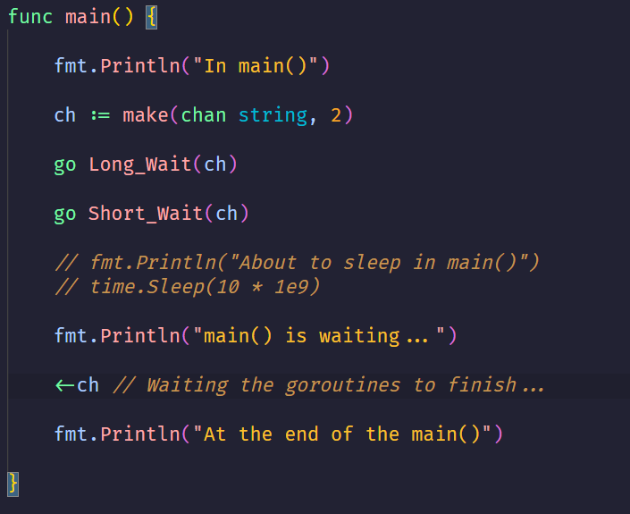
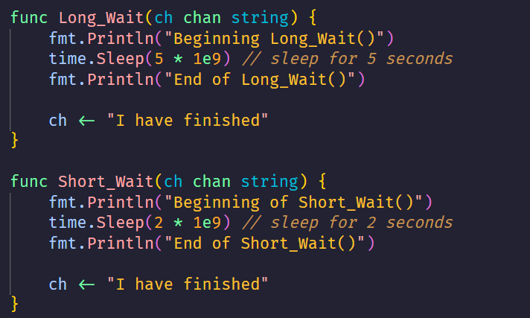
Asynchronous channels:

Slide 14
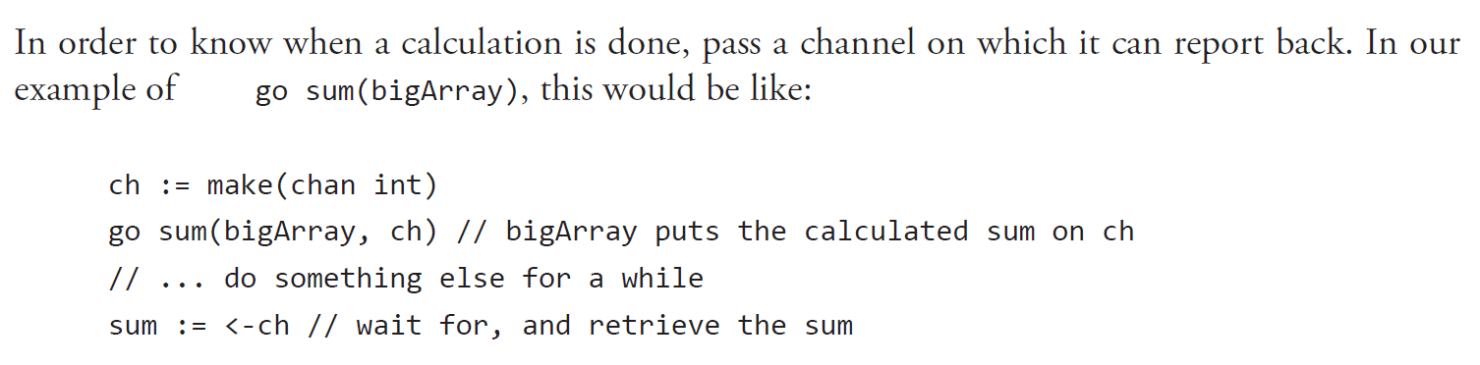
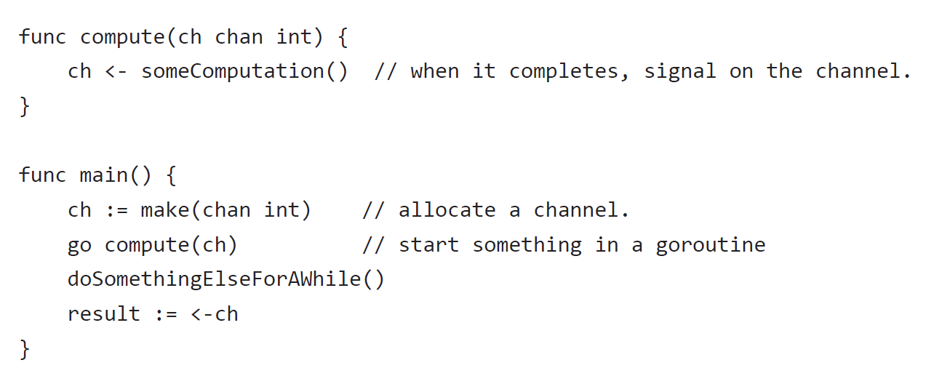
Asynchronous channels (Like Semaphores):

Slide 15
All the content is from chapter 14, Goroutines and channels from THE WAY TO GO book.

